Slide 1

AI Searching Techniques
Introduction to Artificial Intelligence
Dr. Saif Ur Rehman

Slide 2
Today’s Lecture
Heuristically Informed Methods
Best First Search
A* Procedure
Hill Climbing
Beam Search
Adversarial Search
Min-Max Procedure
Static Evaluation Function
Alpha Beta Pruning

Slide 3
A* Searching
Most commonly known form of best-first search.
Finds the shortest path between two points.
It is an extension of Dijkstra’s shortest path algorithm (Dijkstra’s Algorithm).
It has combined features of UCS and greedy best-first search, by which it solve the problem efficiently.
A* search algorithm finds the shortest path through the search space using the heuristic function.
This search algorithm expands less search tree and provides optimal result faster.

Slide 4
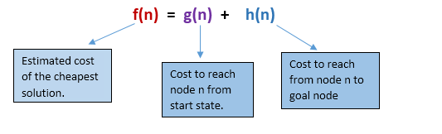
A* Searching
It uses heuristic function h(n), and cost to reach the node n from the start state g(n).
A* algorithm is similar to UCS except that it uses g(n)+h(n) instead of g(n).
In A* search algorithm, we use search heuristic as well as the cost to reach the node.
Hence we can combine both costs as following, and this sum is called as a fitness number.

Slide 5
A* Searching
It is a handy algorithm that is often used for map traversal to find the shortest path to be taken.
A* was initially designed as a graph traversal problem, to help build a robot that can find its own course. However, it still remains a widely popular algorithm for graph traversal.
It searches for shorter paths first, thus making it an optimal and complete algorithm.
An optimal algorithm will find the least cost outcome for a problem,
while a complete algorithm finds all the possible outcomes of a problem.

Slide 6
A* Searching - Heuristics
We can easily calculate g, but how do we actually calculate h?
Determine h's exact value (which is certainly time-consuming).
(or)
Utilize various techniques to approximate the value of h. (less time-consuming).

Slide 7
A* Searching - Heuristics
Approximation Heuristics value
Before using the A* Search Algorithm, pre-calculate the distance between every pair of cells.
Using the distance formula/Euclidean Distance, we may directly determine the precise value of h in the absence of blocked cells or obstructions.

Slide 8
A* Searching - Heuristics
Exact Heuristics value
Manhattan Distance
Diagonal Distance
Euclidean Distance

Slide 9
A* Searching
Step1: Place the starting node in the OPEN list.
Step 2: Check if the OPEN list is empty or not, if the list is empty then return failure and stops.
Step 3: Select the node from the OPEN list which has the smallest value of evaluation function (g+h), if node n is goal node then return success and stop, otherwise
Step 4: Expand node n and generate all of its successors, and put n into the closed list. For each successor n', check whether n' is already in the OPEN or CLOSED list, if not then compute evaluation function for n' and place into Open list.
Step 5: Else if node n' is already in OPEN and CLOSED, then it should be attached to the back pointer which reflects the lowest g(n') value.
Step 6: Return to Step 2.

Slide 10
A* Searching
Step1: Place the starting node in the OPEN list.
Step 2: Check if the OPEN list is empty or not, if the list is empty then return failure and stops.
Step 3: Select the node from the OPEN list which has the smallest value of evaluation function (g+h), if node n is goal node then return success and stop, otherwise
Step 4: Expand node n and generate all of its successors, and put n into the closed list. For each successor n', check whether n' is already in the OPEN or CLOSED list, if not then compute evaluation function for n' and place into Open list.
Step 5: Else if node n' is already in OPEN and CLOSED, then it should be attached to the back pointer which reflects the lowest g(n') value.
Step 6: Return to Step 2.

Slide 11
A* Searching
Advantages
A* search algorithm is the best algorithm than other search algorithms.
A* search algorithm is optimal and complete.
This algorithm can solve very complex problems.

Slide 12
A* Searching
Disadvantages
It does not always produce the shortest path as it mostly based on heuristics and approximation.
A* search algorithm has some complexity issues.
The main drawback of A* is memory requirement as it keeps all generated nodes in the memory, so it is not practical for various large-scale problems.

Slide 13
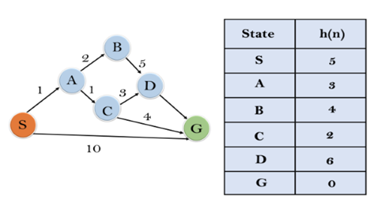
A* Searching
Example

Slide 14
A* Searching
Example
Initialization: {(S, 5)}
Iteration1: {(S--> A, 4), (S-->G, 10)}

Slide 15
A* Searching
Example
Initialization: {(S, 5)}
Iteration1: {(S--> A, 4), (S-->G, 10)}
Iteration2:
{(S--> A-->C, 4)
(S--> A-->B, 7)
(S-->G, 10)}

Slide 16
A* Searching
Example
Initialization: {(S, 5)}
Iteration1: {(S--> A, 4), (S-->G, 10)}
Iteration2:
{(S--> A-->C, 4), (S--> A-->B, 7)
(S-->G, 10)}
Iteration3:
{(S--> A-->C--->G, 6),
(S--> A-->C--->D, 11),
(S--> A-->B, 7),
(S-->G, 10)}

Slide 17
A* Searching
Example
Initialization: {(S, 5)}
Iteration1: {(S--> A, 4), (S-->G, 10)}
Iteration2:
{(S--> A-->C, 4), (S--> A-->B, 7)
(S-->G, 10)}
Iteration3: {(S--> A-->C--->G, 6), (S--> A-->C--->D, 11), (S--> A-->B, 7), (S-->G, 10)}
Iteration 4 will give the final result, as S--->A--->C--->G it provides the optimal path with cost 6.

Slide 18
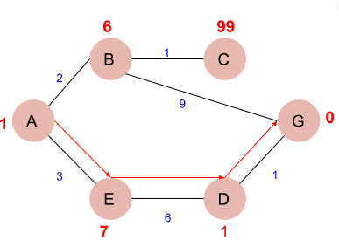
A* Searching
Examples – 2 (Do yourself for Practice)
Heuristic value against each Node is given in Red

Slide 19
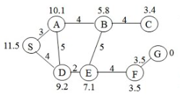
A* Searching
Examples – 3 (Do yourself for Practice)
Heuristic value against each Node is given in Points Value

Slide 20
A* Searching
A* algorithm returns the path which occurred first, and it does not search for all remaining paths.
The efficiency of A* algorithm depends on the quality of heuristic.
A* algorithm expands all nodes which satisfy the condition f(n)

Slide 21
A* Searching
Complete: A* algorithm is complete as long as:
Branching factor is finite.
Cost at every action is fixed.
Optimal: A* search algorithm is optimal if it follows below two conditions:
Admissible: the first condition requires for optimality is that h(n) should be an admissible heuristic for A* tree search. An admissible heuristic is optimistic in nature.
Consistency: Second required condition is consistency for only A* graph-search.
If the heuristic function is admissible, then A* tree search will always find the least cost path.

Slide 22
A* Searching
Time Complexity:
The time complexity of A* search algorithm depends on heuristic function, and the number of nodes expanded is exponential to the depth of solution d.
So the time complexity is O(b^d), where b is the branching factor.
Space Complexity:
The space complexity of A* search algorithm is O(b^d)

